Slide 1






The Dark Side
of Embodiment
Teaming Up With Robots VS Disembodied Agents
Filipa Correia
Samuel Gomes
Samuel Mascarenhas
Francisco S. Melo
Ana Paiva
INESC-ID & University of Lisbon
Robotics: Science and Systems 2020
Notes:
This video summarises the paper called: The dark side of embodiment - teaming up with robots versus disembodied agents.

Slide 2
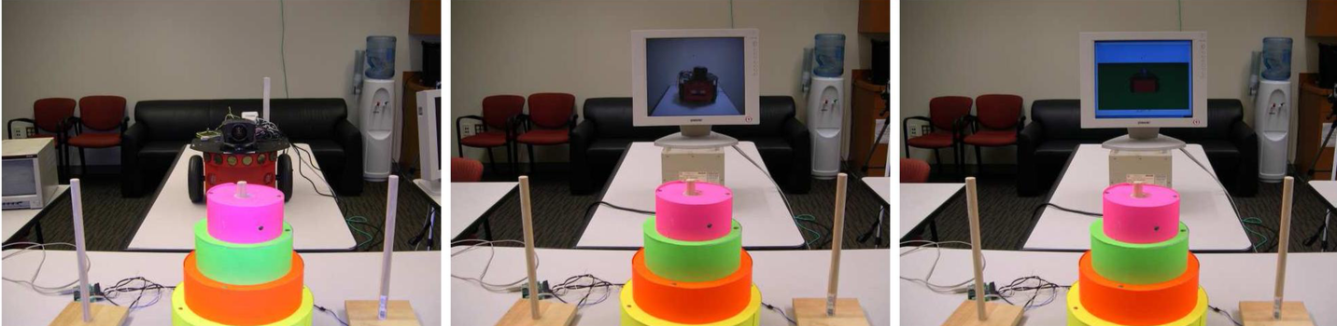
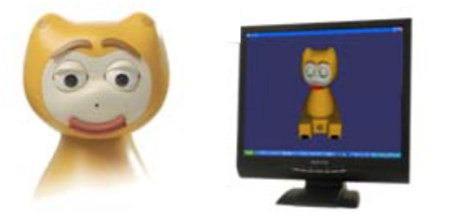
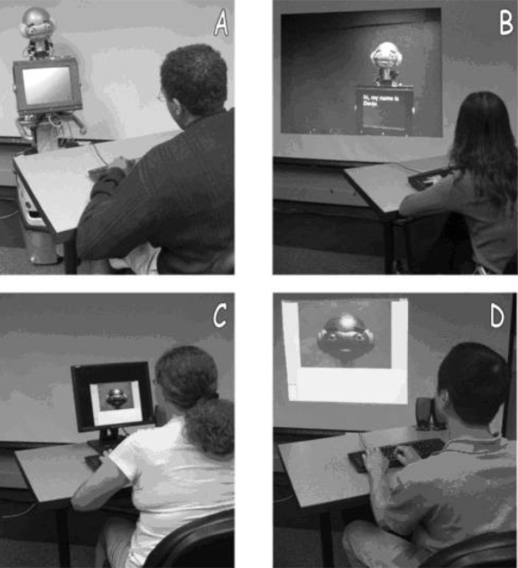
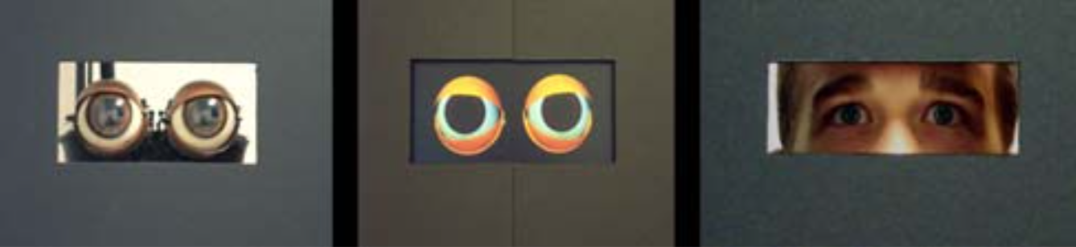
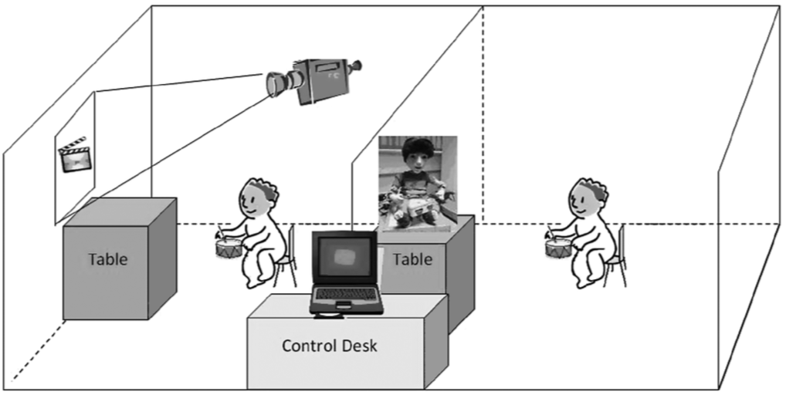
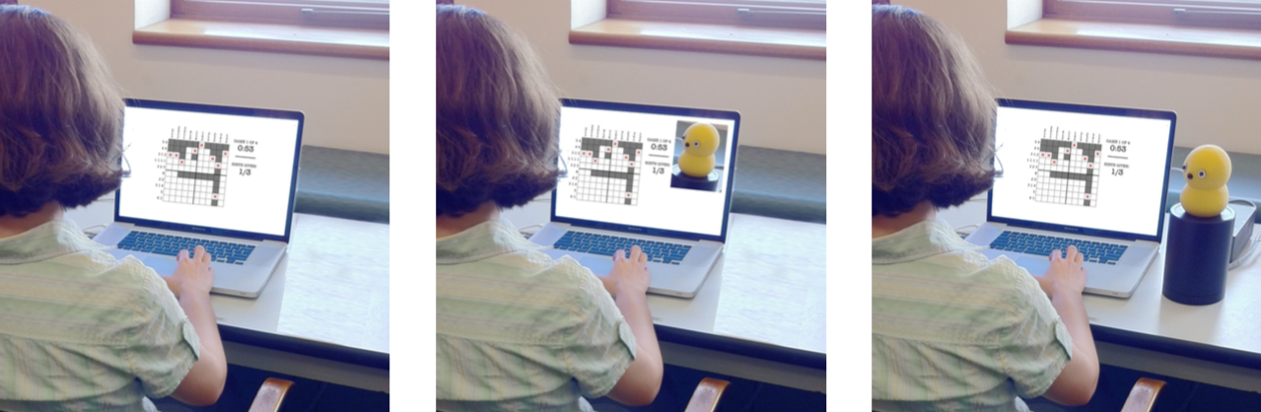
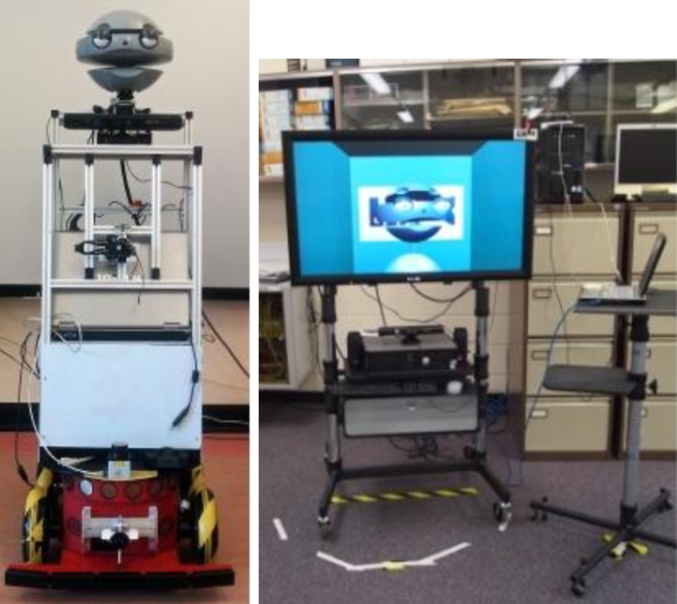
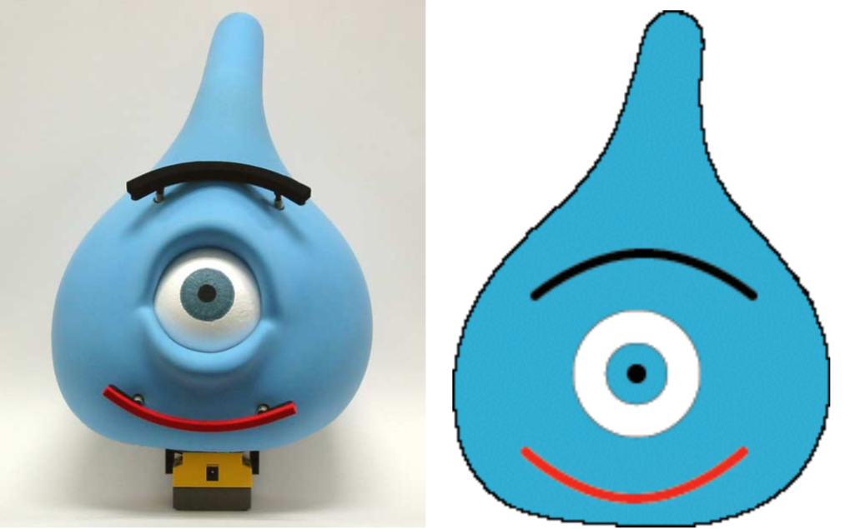
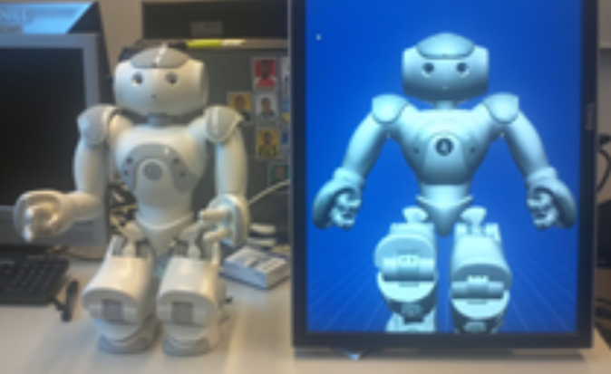
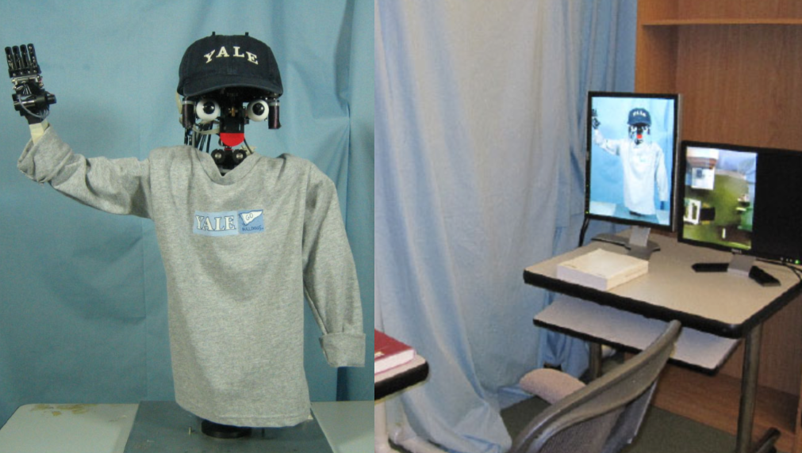
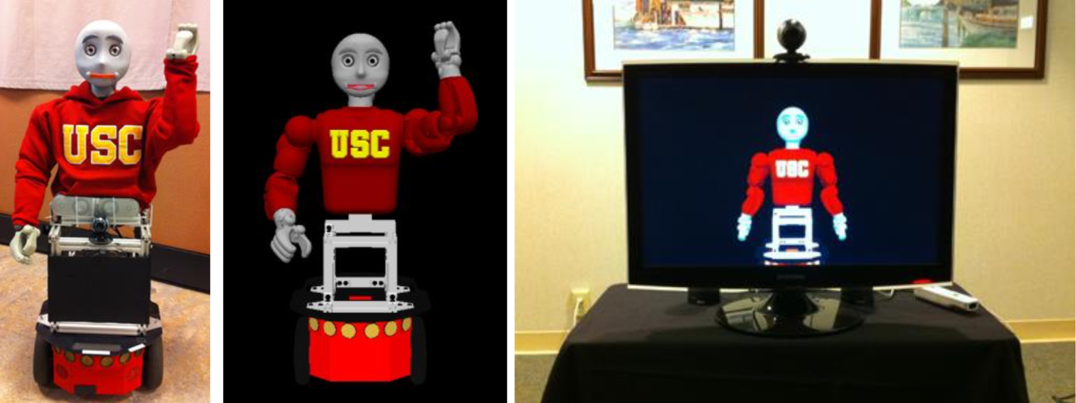
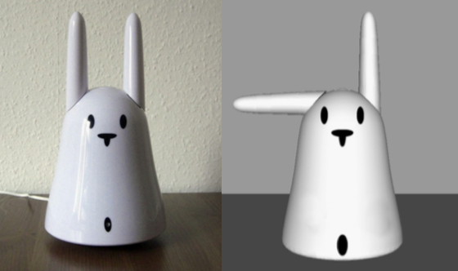
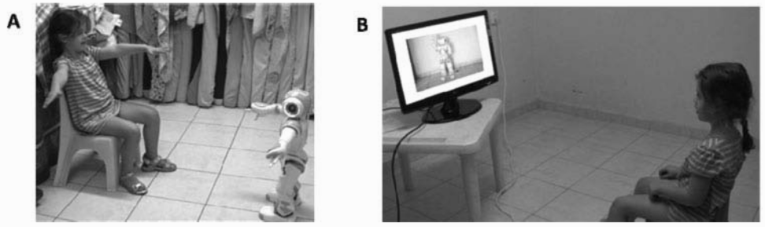
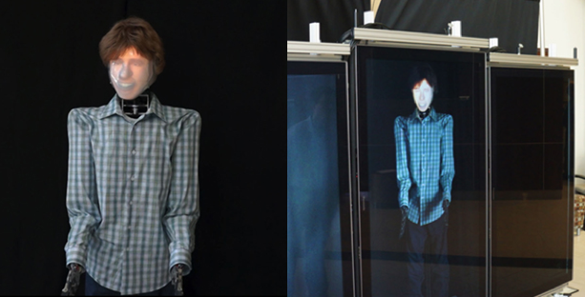
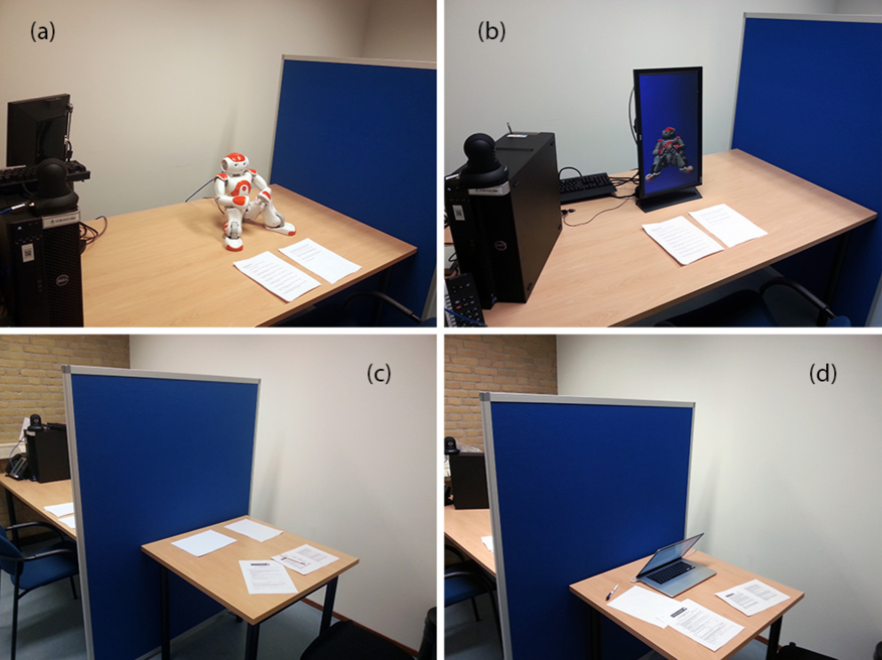
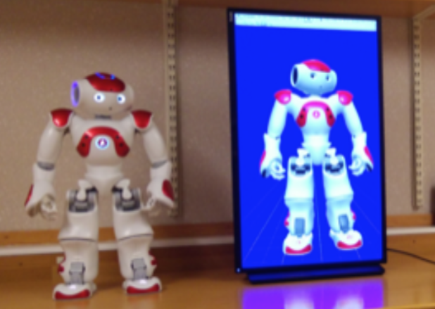
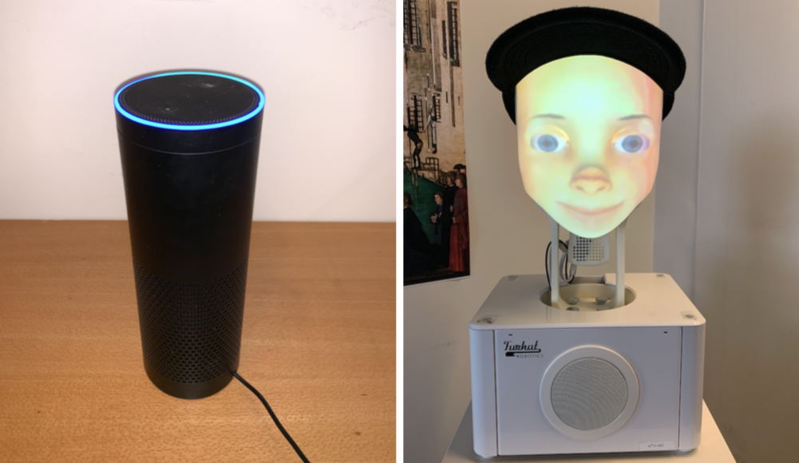
Kidd & Breazeal 2004
Wainer et al. 2007
Pereira et al. 2008
Kiesler et al. 2008
Bartneck 2003
Kose-Bagci et al. 2009
Leyzberg et al. 2012
Segura et al. 2012
Looije et al. 2012
Bainbridge et al. 2010
Fasola & Matarić 2013
Hoffmann & Krämer 2013
Fridin & Belokopytov 2014
Kim et al. 2017
Ligthart & Truong 2015
Thellman et al. 2015
Kontogiorgos et al. 2019
Notes:
Over the past two decades, researchers have been looking at how the embodiment of interactive social agents affects the way humans perceive them, and its impact on the interaction itself. However, to our best knowledge, none of them explores it in group interactions.

Slide 3
Research Questions
What is the impact of embodied affordances
of socially interactive teammates
in a cooperative task?
Notes:
Our paper precisely addresses this issue by exploring the impact of embodied affordances of socially interactive teammates in a cooperative task.

Slide 4
Research Questions
Is human disposition to cooperate different between teaming up with robots and with disembodied agents?
Notes:
In particular, is human disposition to cooperate different between teaming up with robots and with disembodied agents?

Slide 5
Research Questions
Is human disposition to cooperate different between teaming up with robots and with disembodied agents?
How would people perceive artificial teammates that do or do not cooperate with the team in favour of selfish actions? How will those perceptions be affected by their embodiment?
Notes:
Also, how would people perceive artificial teammates that do or do not cooperate with the team in favour of selfish actions? How will those perceptions be affected by their embodiment?

Slide 6

Task
“For The Record”
N-player collaborative game
Variant of a Public Goods
Musical metaphor
Santos, F. P., Mascarenhas, S., Santos, F. C., Correia, F., Gomes, S., & Paiva, A. (2020). Picky losers and carefree winners prevail in collective risk dilemmas with partner selection. Autonomous Agents and Multi-Agent Systems, 34, 1-29.
Notes:
To explore those questions, we used a game called “For the Record”, which is a N-player collaborative game. Although it has a musical metaphor, this game is a variant of a public goods.

Slide 7

Task
to cooperate
to defect
Notes:
Basically, in every round, players individually face a dilemma between to cooperate and to defect. However, individual profits can only be achieved if a certain collective threshold, as a team, is reached.

Slide 8
User Study
3 independent variables:
Embodiment (between-subjects)
Playing strategy of the agents (within-subjects)
Outcome of game (between-subjects)
Notes:
And so, we run a user study where a team of three players (1 human participant and 2 artificial agents) engaged in a session of 5 rounds of For the Record. We manipulated 3 independent variables.

Slide 9
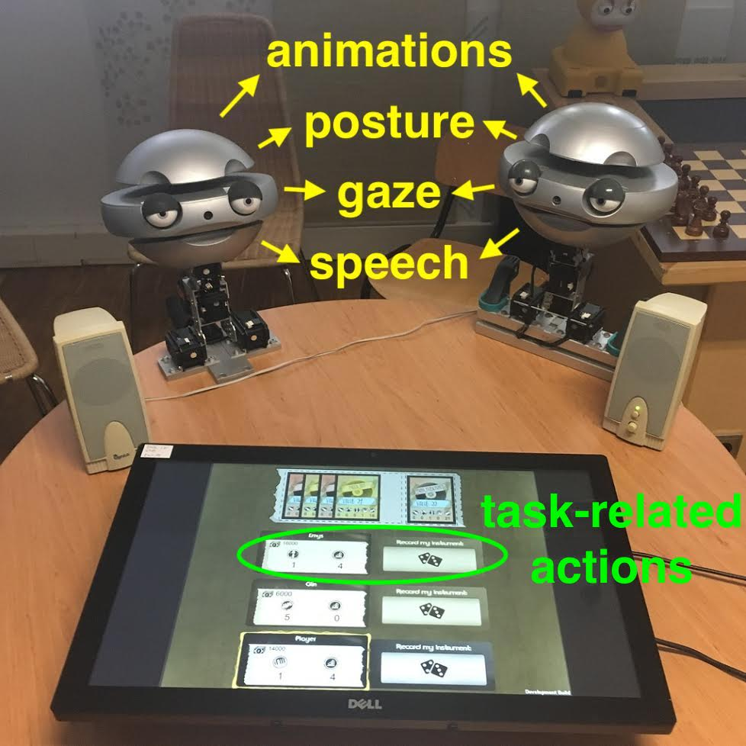
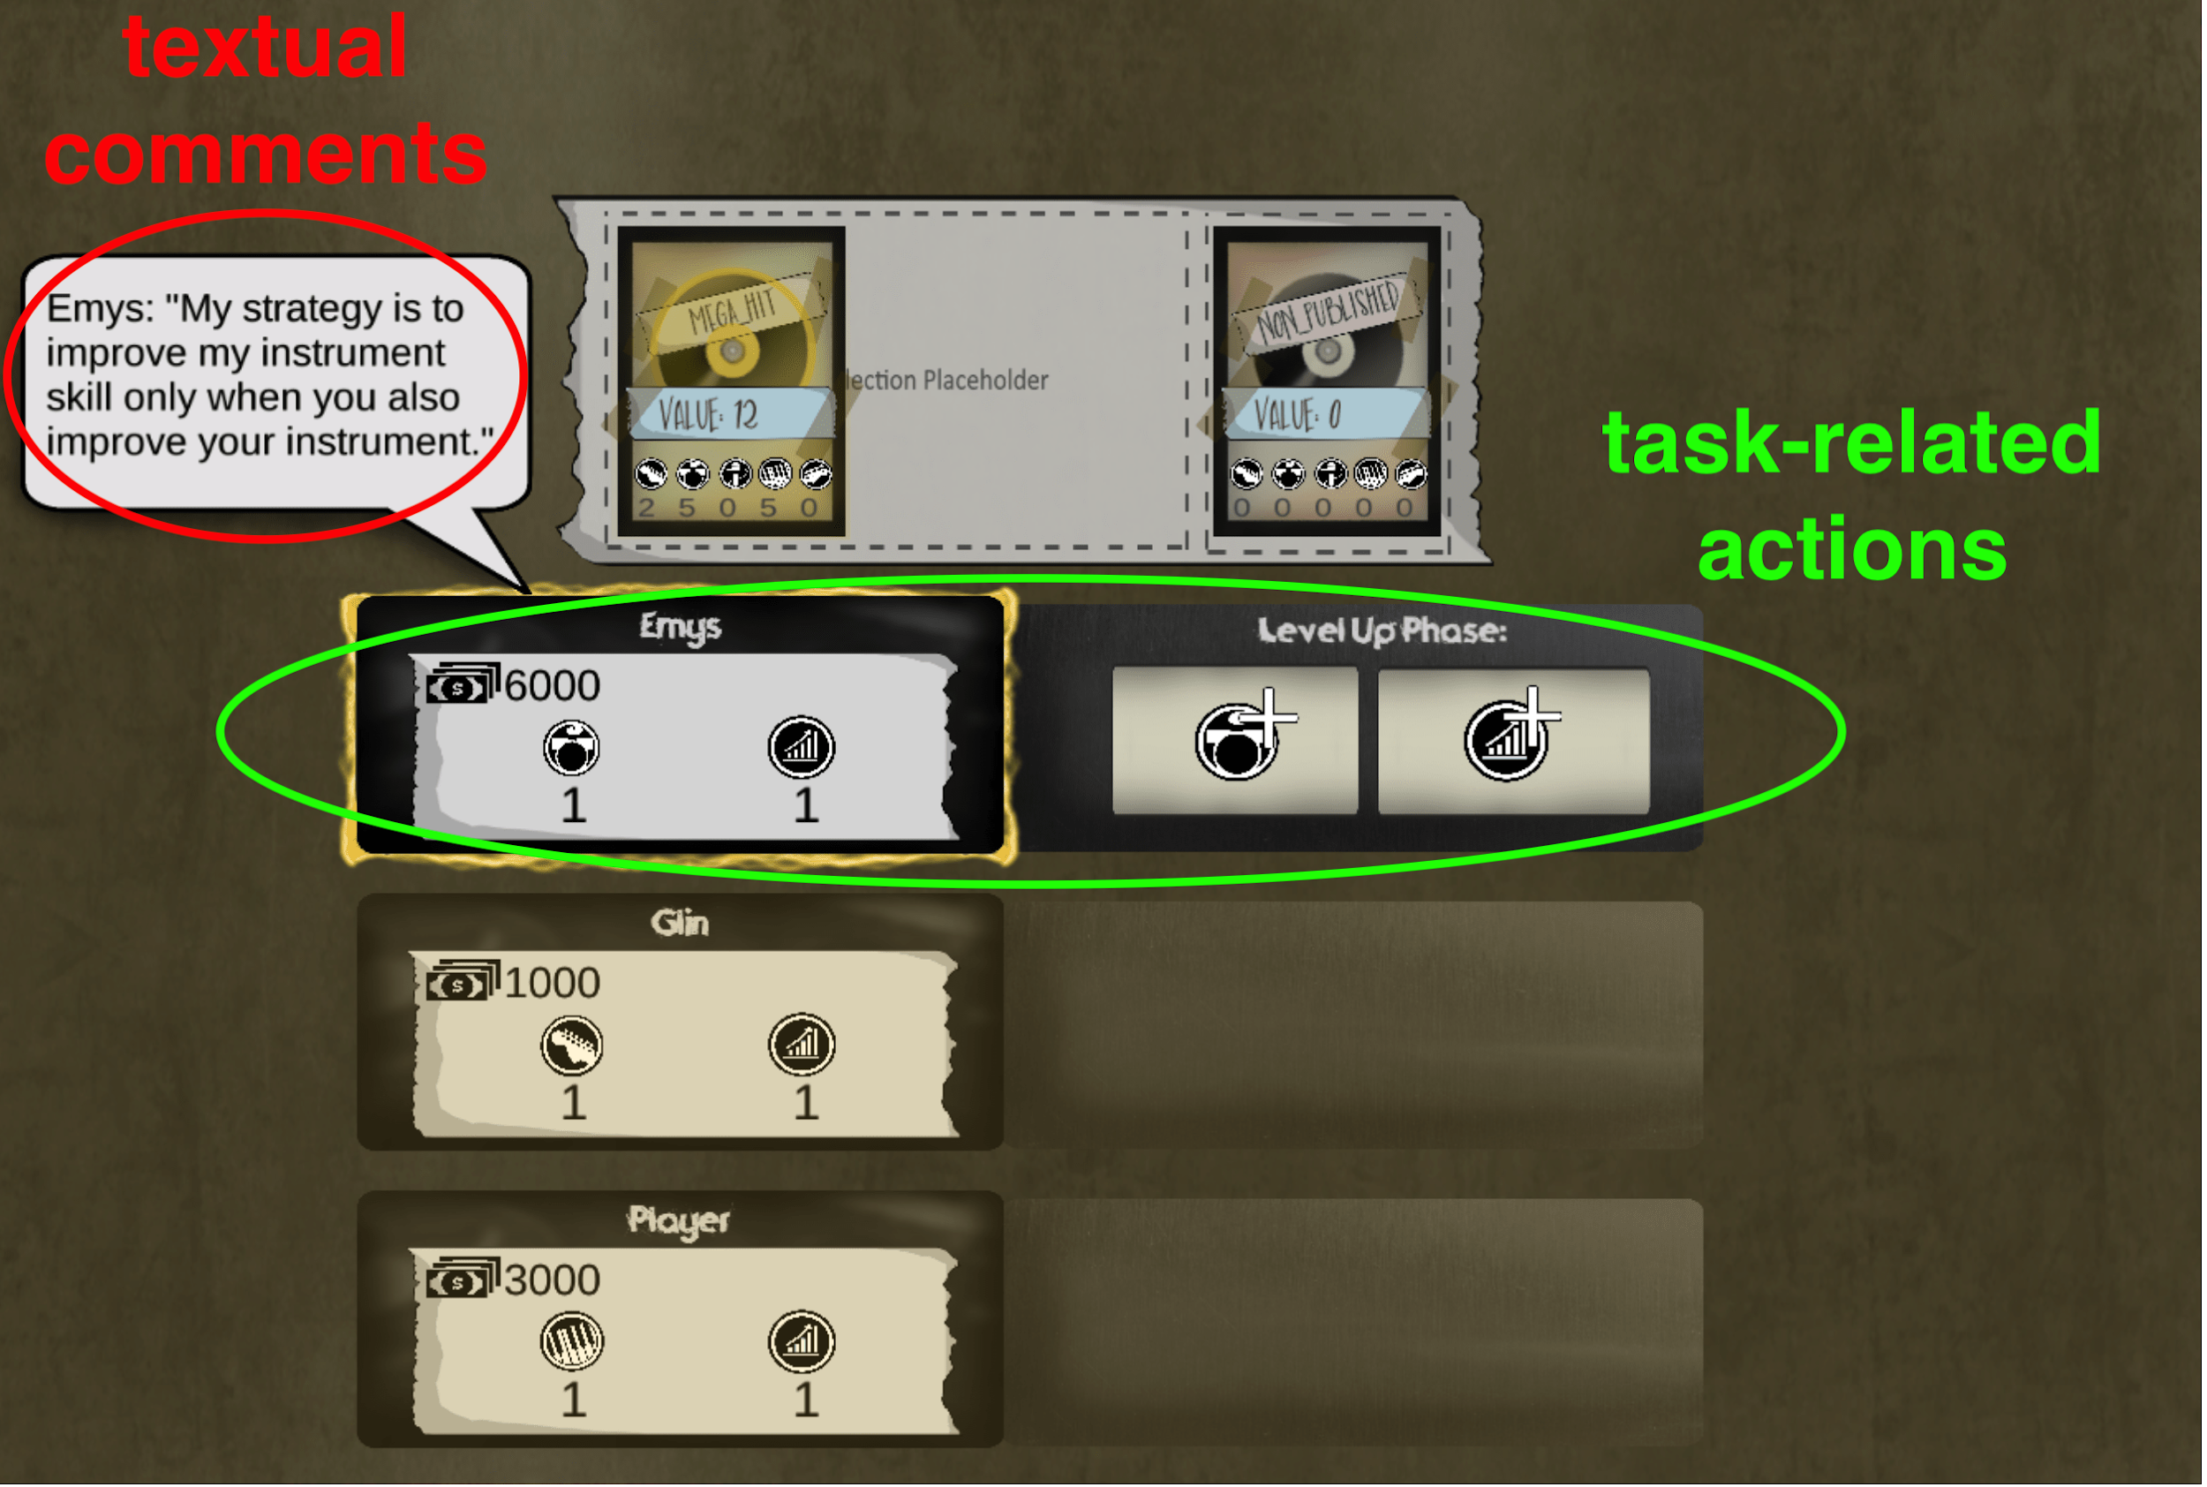
User Study
3 independent variables:
Embodiment (between-subjects)
Robots
Disembodied agents
Playing strategy of the agents (within-subjects)
Outcome of game (between-subjects)
Notes:
First, the embodiment in a between-subjects design. Each participant either partnered with two robots or two disembodied agents.

Slide 10
User Study
3 independent variables:
Embodiment (between-subjects)
Playing strategy of the agents (within-subjects)
Selfish
Prosocial
Outcome of game (between-subjects)
Notes:
The second independent variable was the strategy of the agents to play the cooperative game in a within-subjects design. One agent was selfish and always opted to defect, while the other agent had a prosocial strategy and always opted to cooperate.

Slide 11
User Study
3 independent variables:
Embodiment (between-subjects)
Playing strategy of the agents (within-subjects)
Outcome of game (between-subjects)
The team wins
The team loses
Correia, F., Mascarenhas, S. F., Gomes, S., Arriaga, P., Leite, I., Prada, R., Melo, F. S. & Paiva, A. (2019, March). Exploring prosociality in human-robot teams. In 2019 14th ACM/IEEE International Conference on Human-Robot Interaction (HRI) (pp. 143-151). IEEE.
Notes:
Our third independent variable was the outcome of game, which we decided to control based on previous findings.

Slide 12
Hypotheses
Cooperation¹ - Participants will be more prosocial in the embodied condition compared to the disembodied condition.
¹Cooperation was measured by the strategy participants took to play the social dilemma.
Notes:
One of our hypotheses is related to cooperation. We predicted that participants themselves will be more prosocial when teaming up with robots compared to disembodied agents, as previous findings report more compliance with social norms around robots.

Slide 13
Hypotheses
Cooperation - Participants will be more prosocial in the embodied condition compared to the disembodied condition.
Perception of the team² - Participants will perceive the team more positively in the embodied condition compared to the disembodied condition.
²Perception of the team was measured with subjective scales of group identification and group trust.
Notes:
Because human disposition to cooperate is closely related to several interpersonal aspects, such as trust, we have also hypothesised that participants would perceive the team more positively when the teammates were embodied.

Slide 14
Hypotheses
Cooperation - Participants will be more prosocial in the embodied condition compared to the disembodied condition.
Perception of the team - Participants will perceive the team more positively in the embodied condition compared to the disembodied condition.
Perception of the prosocial/selfish teammate³ - The perception of the prosocial and the selfish agents will be, respectively, more positive and more negative when it is embodied than when it is disembodied.
³Perception of the teammates was measured with subjective RoSAS scale.
Notes:
Finally, because to cooperate can be seen as the moral norm in this social dilemma, we expected that participants would perceive the prosocial agent more positively when it was embodied. Respectively, the selfish agent would be perceived more negatively.

Slide 15
Sample
Total of 111 participants (age [22, 63], M_{age} = 36.1 ± 10.8)
70 embodied condition
In-person recruitment
41 disembodied condition
Amazon Mechanical Turk
Notes:
The sample that we collected had a total of 111 participants with a mean age of 36 years old, from which 70 people belonged to the embodied condition and 41 to the disembodied condition.

Slide 16
Results - Cooperation
No significant difference were observed between the cooperation of the two conditions of embodiment
(Z=−0.565,p= 0.572,r=0.055)
Notes:
We found no significant differences in the cooperation rate of participants that teamed up with robots, compared to participants that teamed up with disembodied agents.

Slide 17
Results - Perception of the team
A significant main effect of the embodiment on the group identification
(F(1,106) =15.589,p <0.001,r= 0.358)
No significant effect of embodiment was found for group trust
(F(1,106) = 0.423,p= 0.517,r= 0.063)
Notes:
Regarding the perception of the team, participants perceived higher group identification when collaborating with the embodied agents compared to disembodied, but no similar effect was found on group trust.

Slide 18
Results - Perception of the teammates
A significant interaction effect between the strategy and the embodiment on the perception of warmth
(F(1,106) = 4.566,p=0.035,r= 0.202)
A significant interaction effect between the strategy and the embodiment on the perception of competence
(F(1,106) = 41.909,p= 0.001,r= 0.532)
Notes:
Regarding the perceptions of the agents, we found two significant interaction effects in both the perceive warmth and perceived competence.

Slide 19
Results - Perception of the prosocial
The warmth and competence attributed to the prosocial agent was significantly different for each type of embodiment
(U=1089, Z=-2.015, p=0.044, r=0.192; U=449.5, Z=-5.974, p<0.001, r=0.570, respectively)
Notes:
In post-hoc analyses, we compared how people perceived the prosocial agent between embodiment conditions. Participants attributed both less warmth and less competence when it was embodied compared to when it was disembodied.

Slide 20
Results - Perception of the selfish
The warmth attributed to the selfish agent was not significantly different for each type of embodiment
(U=1407, Z=-0.171, p=0.864, r=0.016)
Notes:
For the selfish agent, we did not find a significant difference on the attribution of warmth between the two conditions of embodiment.

Slide 21
Results - Perception of the selfish
The competence attributed to the selfish agent was significantly different for each type of embodiment
(U=1049, Z=-2.373, p=0.018, r=0.225)
Notes:
However, people perceived the selfish agent as significantly more competent when it was embodied compared to when it was disembodied.

Slide 22
Discussion
The embodiment of the robots had an important role on the sense of identity with the team.
Notes:
Wrapping up the most important results, by looking at the cooperation of the participants and their perceptions of the team, it seems the embodiment of robots had an important role on the sense of identity with the team.

Slide 23
Discussion
The embodiment of the robots had an important role on the sense of identity with the team.
Contrary to our hypothesis, participants were not more cooperative in the embodied condition, nor did they trust their team more compared to having disembodied teammates.
Notes:
However, it was not be not enough to inhibit selfish behaviours by the participants.

Slide 24
Discussion
The embodiment of the robots had an important role on the sense of identity with the team.
Contrary to our hypothesis, participants were not more cooperative in the embodied condition, nor did they trust their team more compared to having disembodied teammates.
Relation between trust and cooperation
Presence of unconditional defector
Notes:
We speculate that participants’ degree of cooperation might be related to subjective measure of group trust. Also, the presence of an unconditional defector might per se constrain cooperation.

Slide 25
Discussion
Participants perceived the prosocial more negatively when it was embodied compared to when it was disembodied.
Participants perceived the selfish more positively when it was embodied compared to when it was disembodied.
Notes:
Regarding the perception of the teammates, we found opposite results to what we were expecting. It seems the presence of an embodiment reduced, rather than increased, the gap between the perceptions of the selfish and the prosocial teammates.

Slide 26
Discussion
Participants perceived the prosocial more negatively when it was embodied compared to when it was disembodied.
Participants perceived the selfish more positively when it was embodied compared to when it was disembodied.
The presence of an embodiment introduces (social) factors into the evaluation of an agent.
Notes:
We speculate that presence of an embodiment introduced other factors into the evaluation of the agents, beyond their objective strategy during the task.

Slide 27
Discussion
Participants perceived the prosocial more negatively when it was embodied compared to when it was disembodied.
Participants perceived the selfish more positively when it was embodied compared to when it was disembodied.
The presence of an embodiment introduces (social) factors into the evaluation of an agent.
The Dark Side of Embodiment
Notes:
As a result, if embodied affordances are able to mask selfish behaviours, we consider that a dark side of the embodiment may emerge.

Slide 28





The Dark Side
of Embodiment
Teaming Up With Robots VS Disembodied Agents
Robotics: Science and Systems 2020
filipacorreia@tecnico.ulisboa.pt

Slide 29
Extra slides (related work)
IGNORE

Slide 30

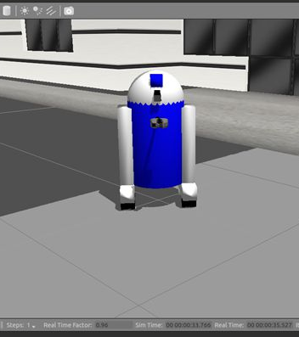
Notes:
Social agents can certainly be embodied in many different ways. But what exactly is the impact of their embodied affordances?

Slide 31
Notes:
And what are the features we use to create a mental model of an embodiment?! [play the sound]

Slide 33
Kidd & Breazeal 2004
Wainer et al. 2007
Pereira et al. 2008
Kiesler et al. 2008
Bartneck 2003
Kose-Bagci et al. 2009
Leyzberg et al. 2012
Segura et al. 2012
Looije et al. 2012
Bainbridge et al. 2010
Fasola & Matarić 2013
Hoffmann & Krämer 2013
Fridin & Belokopytov 2014
Kim et al. 2017
Ligthart & Truong 2015
Thellman et al. 2015
Kontogiorgos et al. 2019
Notes:
While reviewing the literature on the impact of embodiment of interactive social agents, we noticed two issues.

Slide 34
Kidd & Breazeal 2004
Wainer et al. 2007
Pereira et al. 2008
Kiesler et al. 2008
Bartneck 2003
Kose-Bagci et al. 2009
Leyzberg et al. 2012
Segura et al. 2012
Looije et al. 2012
Bainbridge et al. 2010
Fasola & Matarić 2013
Hoffmann & Krämer 2013
Fridin & Belokopytov 2014
Kim et al. 2017
Ligthart & Truong 2015
Thellman et al. 2015
Kontogiorgos et al. 2019
Notes:
First, a few studies compare between robots and minimalist embodiments.

Slide 35
Kidd & Breazeal 2004
Wainer et al. 2007
Pereira et al. 2008
Kiesler et al. 2008
Bartneck 2003
Kose-Bagci et al. 2009
Leyzberg et al. 2012
Segura et al. 2012
Looije et al. 2012
Bainbridge et al. 2010
Fasola & Matarić 2013
Hoffmann & Krämer 2013
Fridin & Belokopytov 2014
Kim et al. 2017
Ligthart & Truong 2015
Thellman et al. 2015
Kontogiorgos et al. 2019
Notes:
And second, to our best knowledge, none compares the impact of embodiment in group interactions and what should be the appearance of cooperative machines.

Slide 36
Pereira et al. 2008
Wainer et al. 2007
Leyzberg et al. 2012
Kose-Bagci et al. 2009
Fasola & Matarić 2013
Fridin & Belokopytov 2014
Notes:
Over the past two decades, researchers have tried to understand how the embodiment of interactive social agents affects the way humans perceive them, and the impact it has on the interaction itself. Overall there seems to be a positive impact of the physical embodiment...

Slide 37
Kidd & Breazeal 2004
Bartneck 2003
Kiesler et al. 2008
Looije et al. 2012
Segura et al. 2012
Kontogiorgos et al. 2019
Thellman et al. 2015
Ligthart & Truong 2015
Notes:
… nonetheless, there are also some papers reporting non-significant differences when comparing robots and their virtual counterparts. As a result, there are several particularities about the embodiment of a robot that still puzzle researchers.

Slide 38
Hoffmann & Krämer 2013
Notes:
Are they a matter of being physically-embodied in the real world as opposed to being virtually-embodied?

Slide 39
Bainbridge et al. 2010
Notes:
Are they a matter of the physical presence and proximity to the user?

Slide 40
Kim et al. 2017
Notes:
Or are they related to the degree of social presence, agency or realism of the agent?

Slide 41
“(...) what, if anything,
is special about
material embodiment?”
Dautenhahn, K., Ogden, B., & Quick, T. (2002). From embodied to socially embedded agents–implications for interaction-aware robots. Cognitive Systems Research, 3(3), 397-428.

